Slide 1
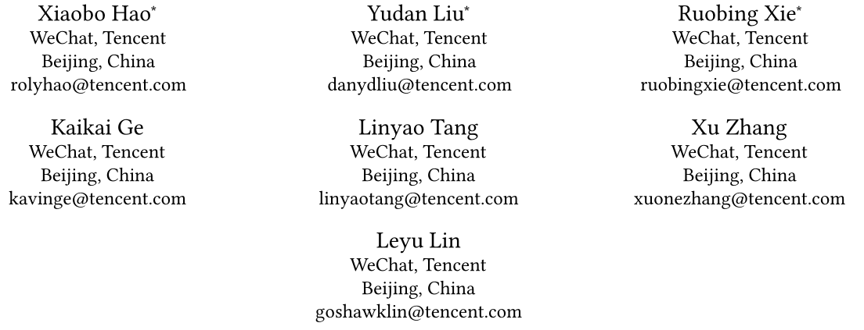
Adversarial Feature Translation for Multi-domain
Recommendation
2021.10.25 • ChongQing
Reported by Gu Tang

Slide 2
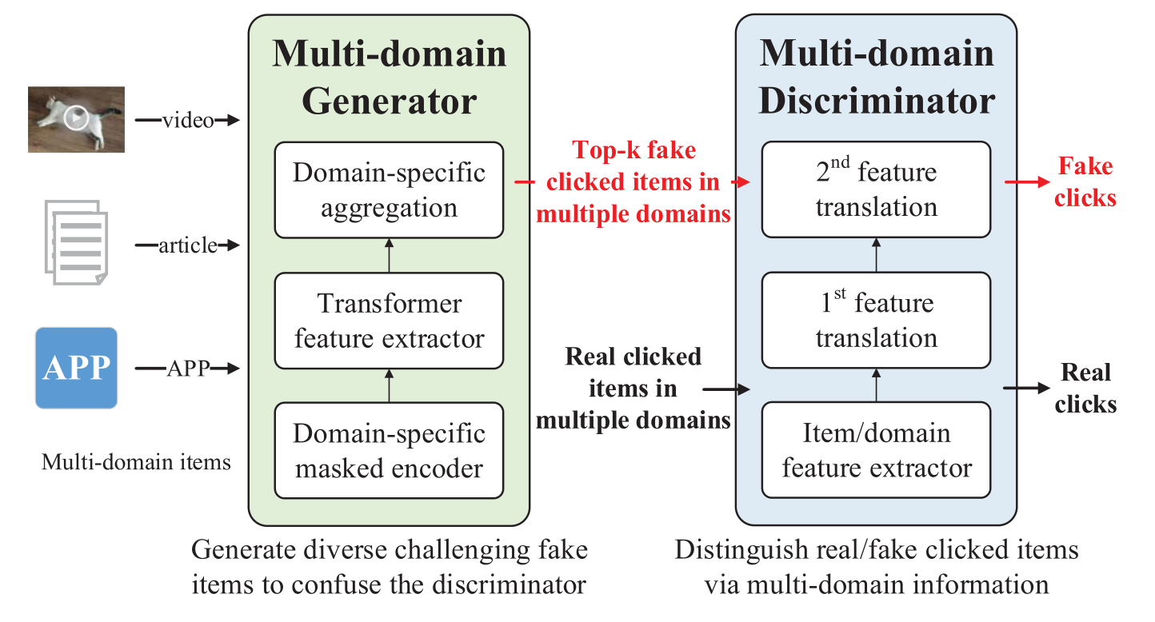
Introduction
(1) the sparsity of user-item pair-wise click behaviors
(2) the sparsity of feature interactions within and between different domains

Slide 3
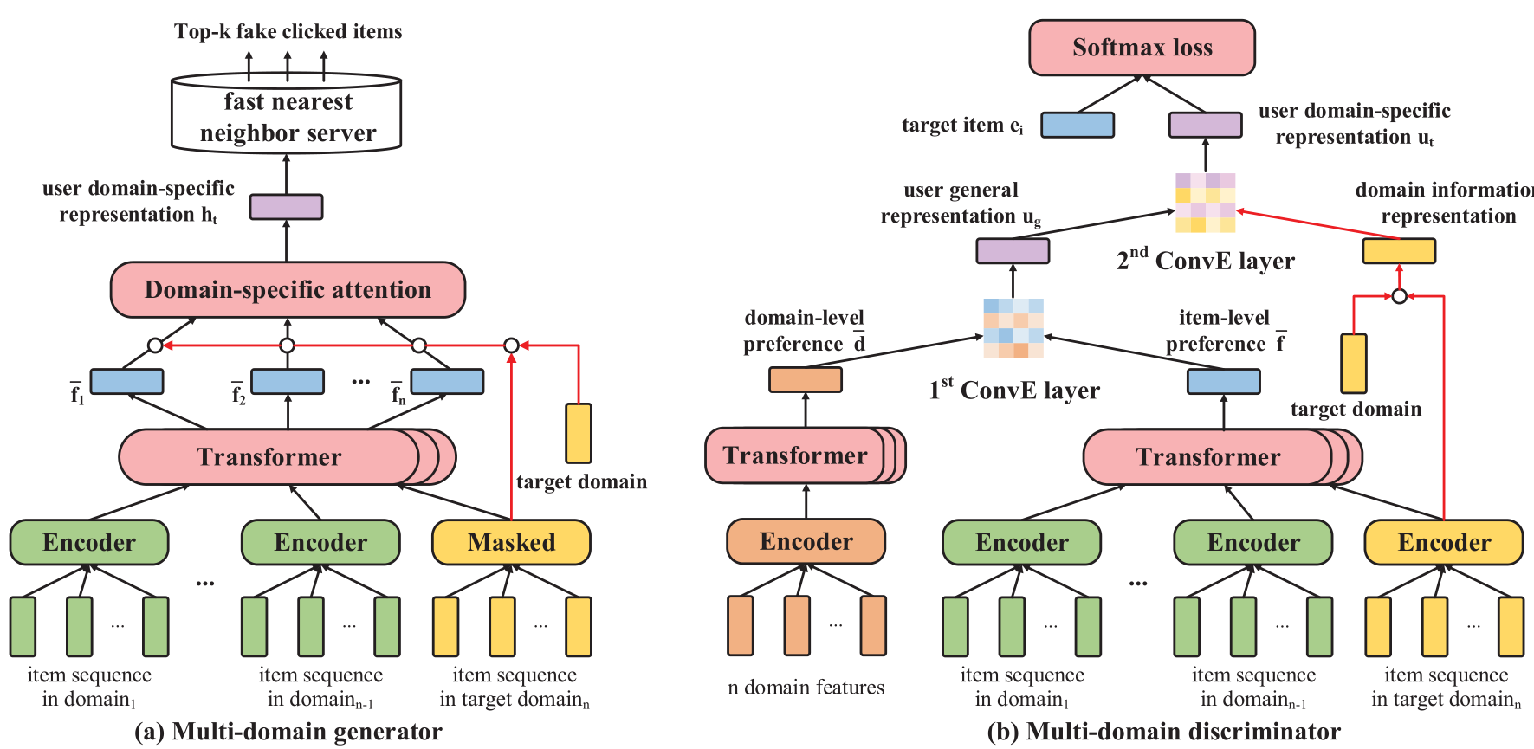
Method

Slide 4
Method

Slide 5
Method

Slide 6
Method
Notes:
最大平均偏差:sup是求上界

Slide 7
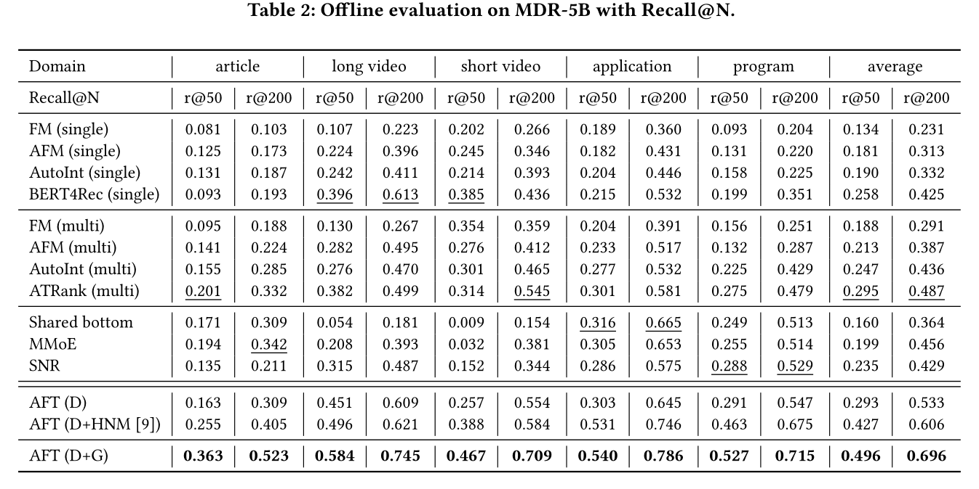
Experiment

Slide 8
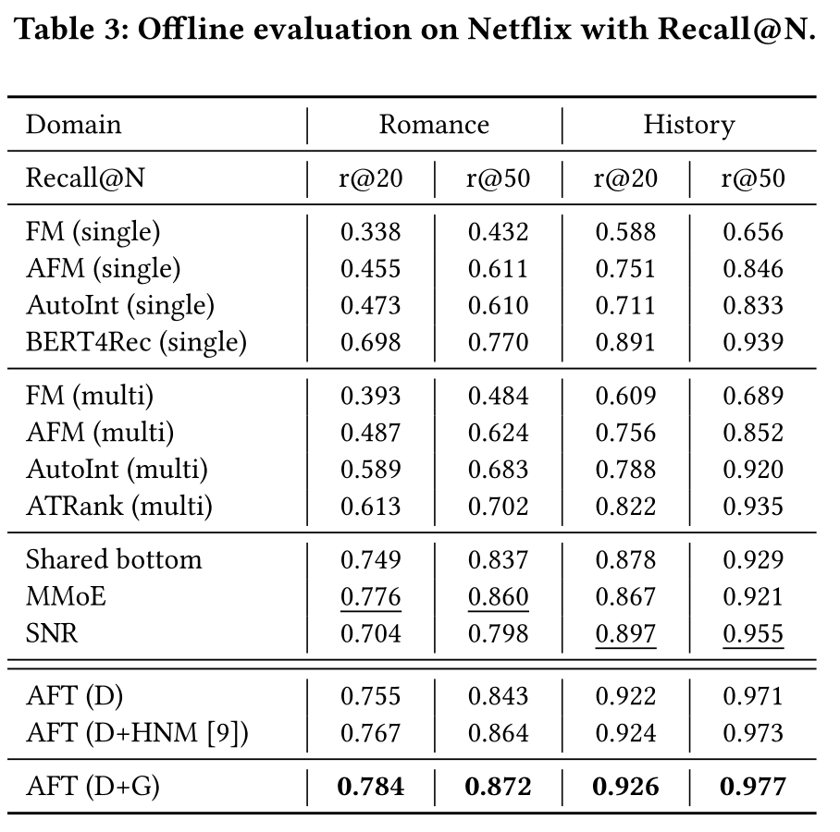
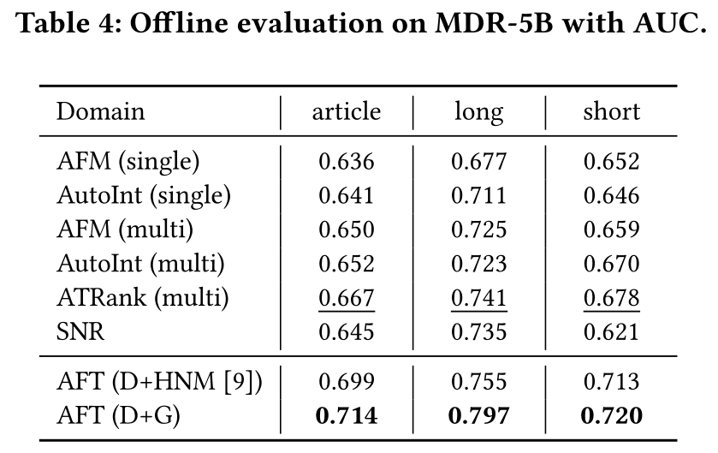
Experiments

Slide 9
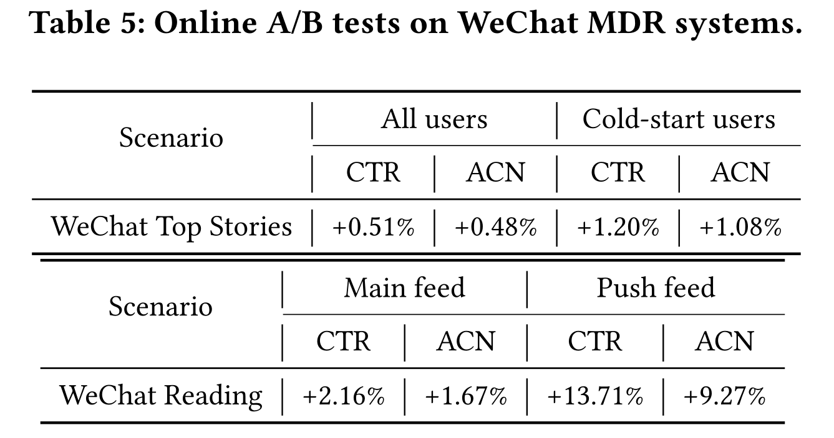
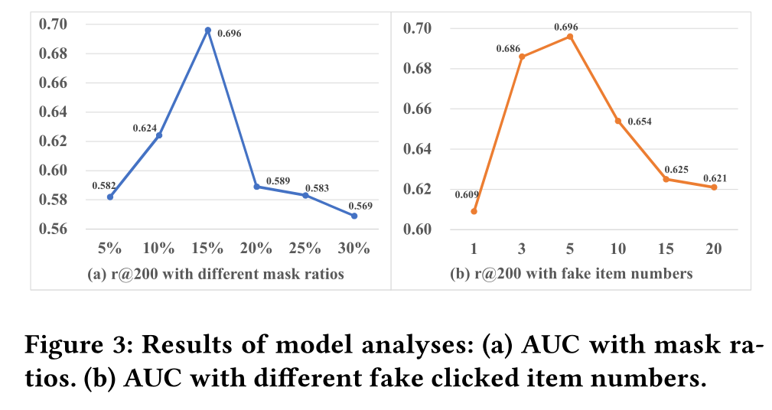
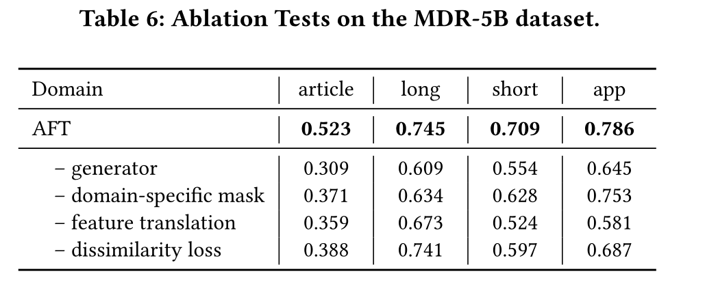
Experiments

Slide 10
Thanks

